Slide 1
WEARABLE PHOTOPLETHYSMOGRAM (PPG)
By: Jakub Glebocki
Joshua Huff
Akshaj Arora

Slide 2
Introduction
Photoplethysmography(PPG) is technology used to develop small, wearable, pulse rate sensors.
This is used in smart watches such as Fitbit, Apple watch etc.
Allowing it to be in such small devices gives the benefit of measuring your pulse rate while you are on the go and anytime you want.
The device is wearable, and doesn’t cause discomfort. It’s almost as if you had a regular glove on!

Slide 3
How does it work?
In each cardiac cycle the heart pump blood to the periphery. When pulse reaches the skin we are able to distinguish arteries and arterioles.
The change in volume caused by the pressure pulse is detected by measuring the amount of light reflected.
The delay between the emission and detection of the light is then used to recreate the pulse signal.

Slide 4
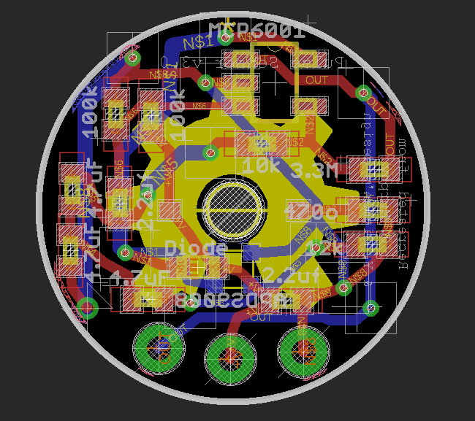
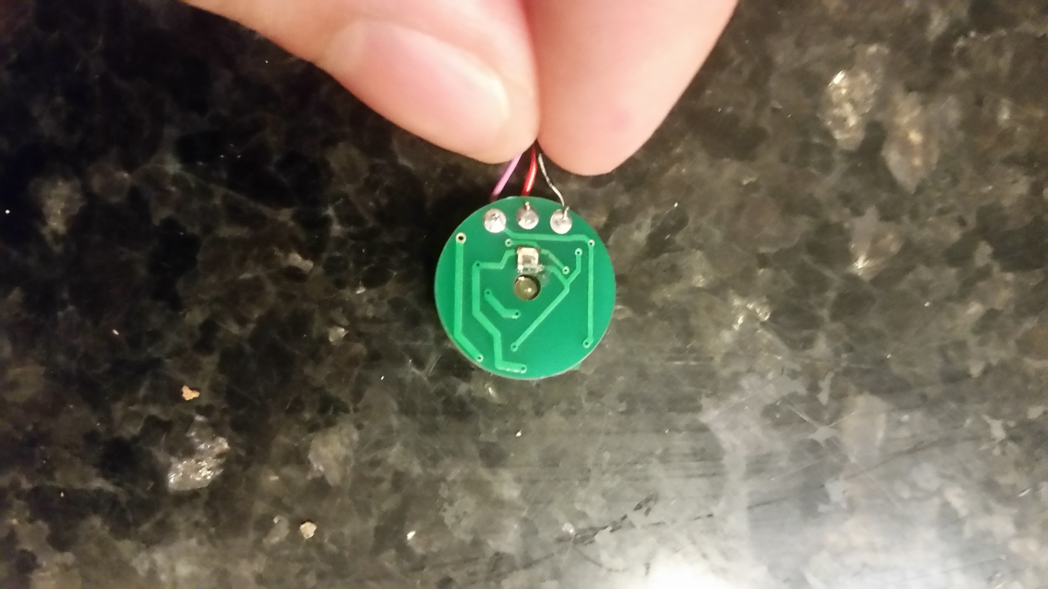
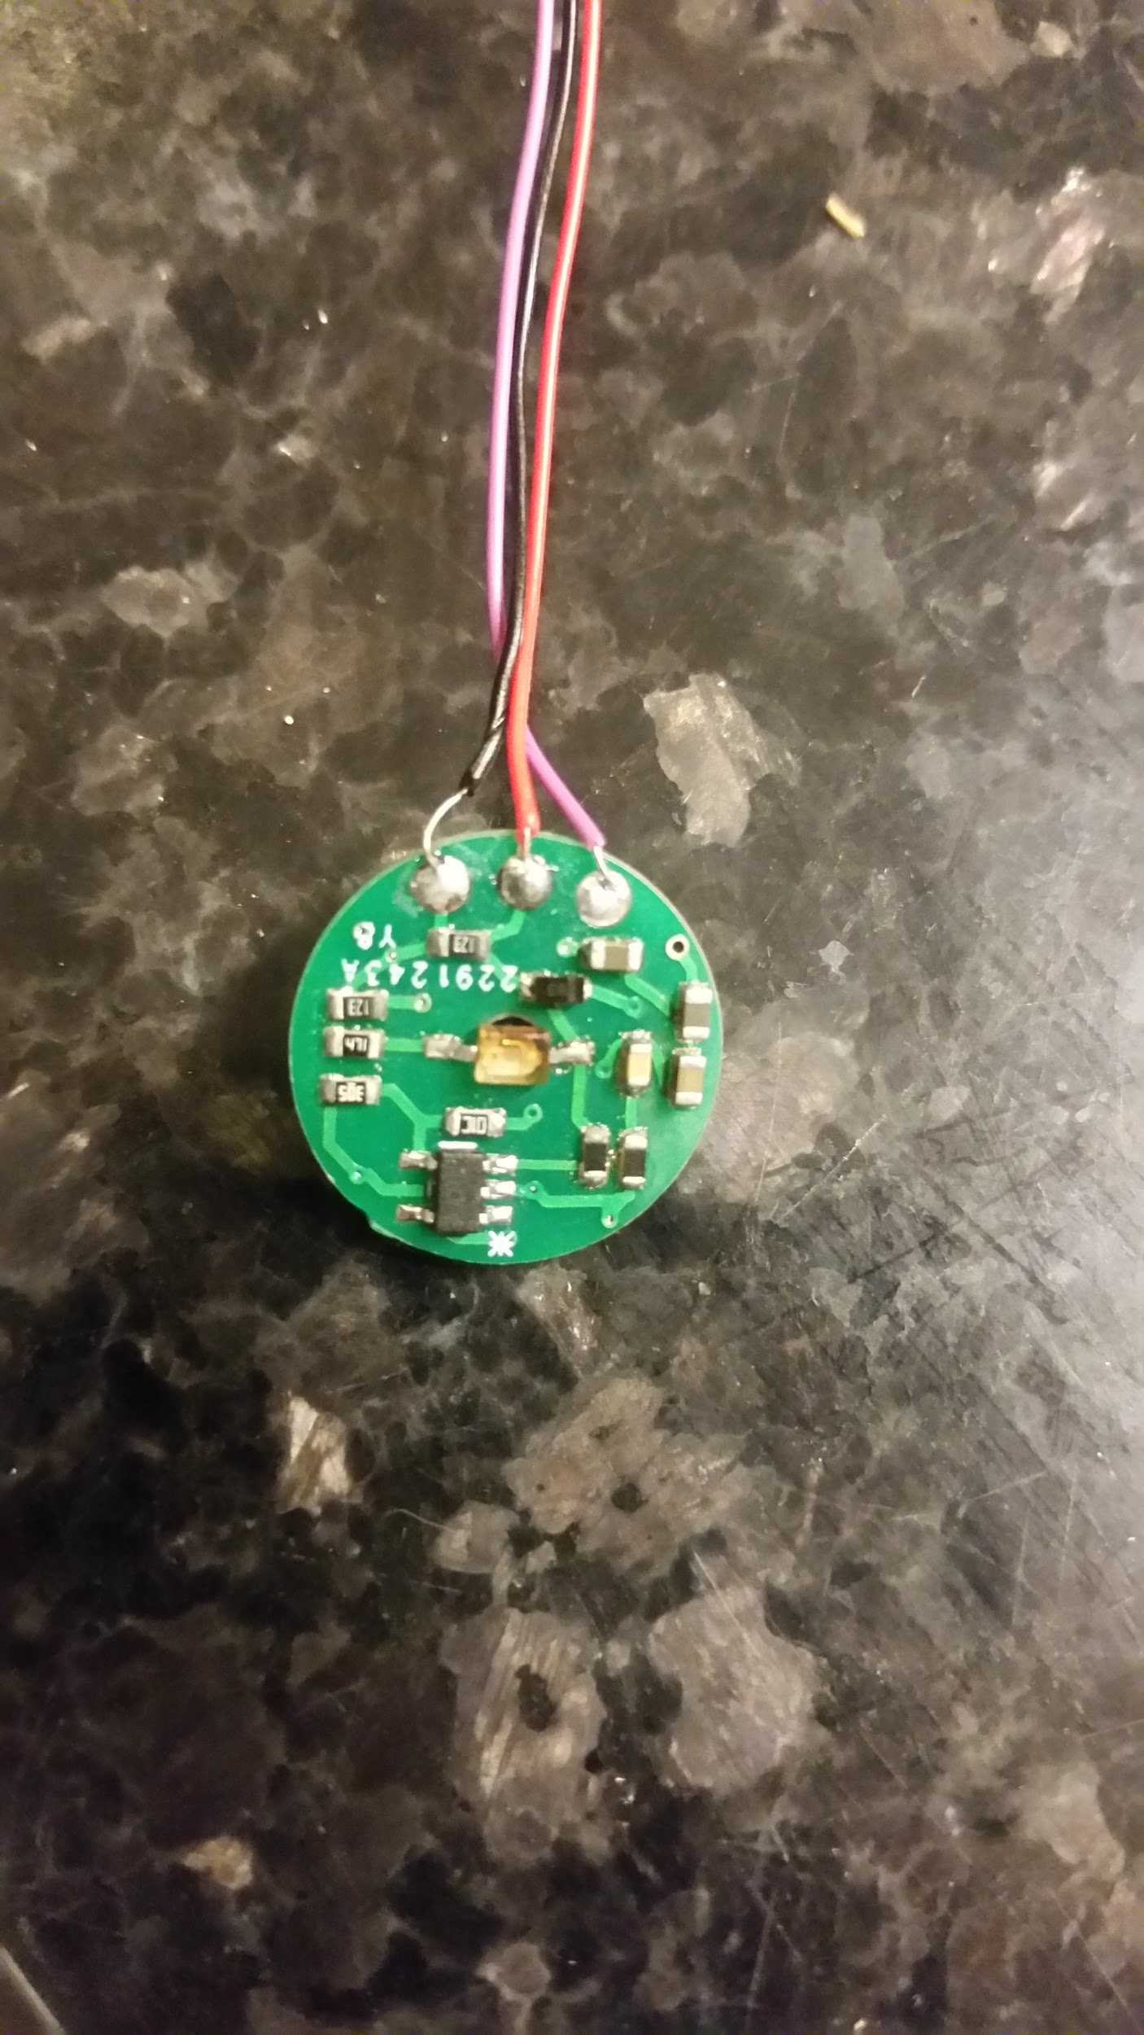
Board’s

Slide 5
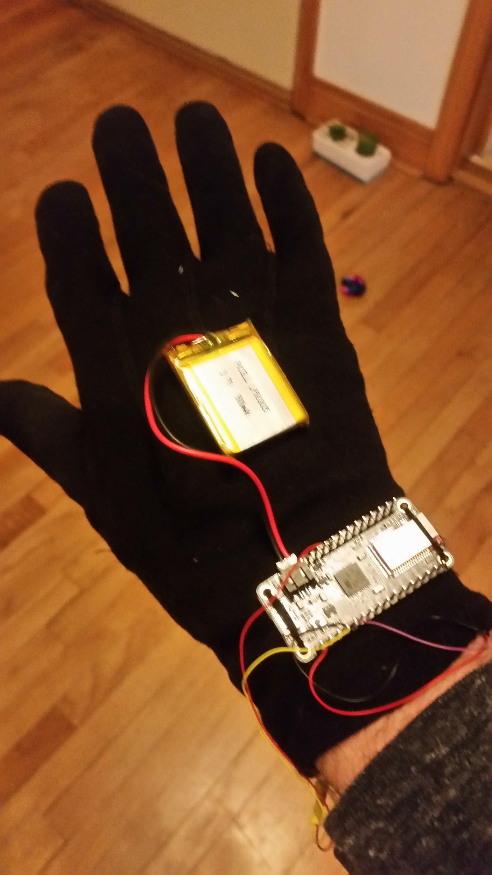
Wearable Device
The Sensor located in the thumb
The vibrated will vibrated with the the patient's pulse if the device is correctly attached.
The a signal is sent through Bluetooth the device returns the patient’s BPM

Slide 6
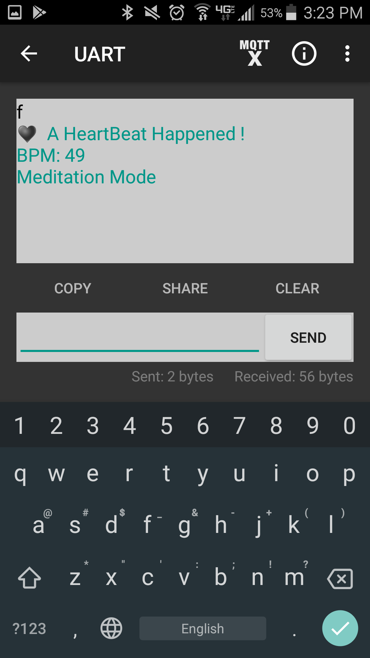
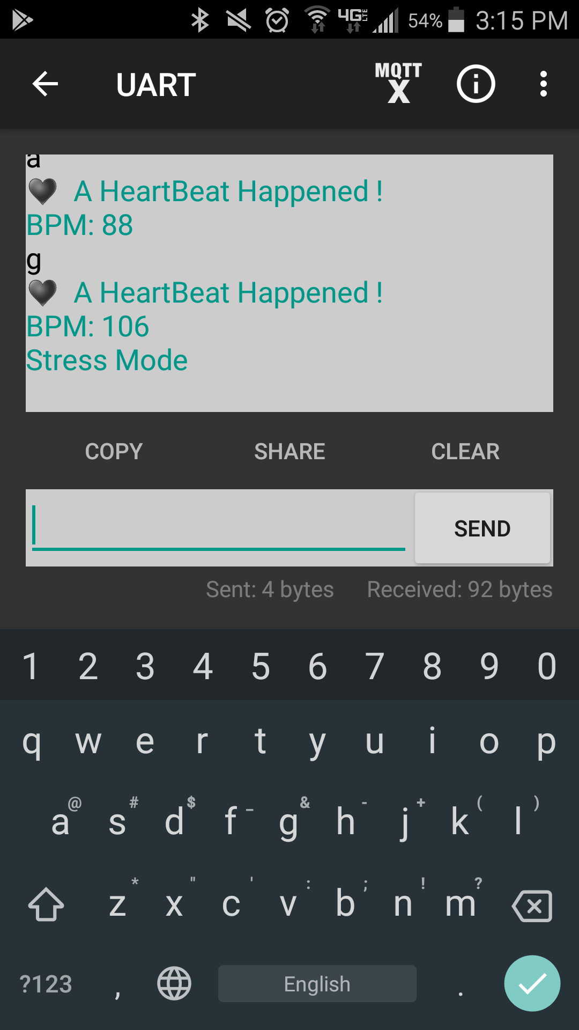
Stress and Meditation
If BPM are below 50 the device will display meditation
If the BPM are above 90 the device will display stress

Slide 7
Code for Stress and Meditation mode
Add Stress Mode Code(BPM > 90)
while ( ble.available() ) { if (pulseSensor.sawStartOfBeat()) { // Constantly test to see if "a beat happened". ble.println("♥ A HeartBeat Happened ! "); // If test is "true", print a message "a heartbeat happened". ble.print("BPM: "); // Print phrase "BPM: " ble.println(myBPM); // Print the value inside of myBPM. if (myBPM >= 90){ ble.println("Stress Mode"); } }
Add Meditation Mode Code (BPM < 60)
while ( ble.available() ) { if (pulseSensor.sawStartOfBeat()) { // Constantly test to see if "a beat happened". ble.println("♥ A HeartBeat Happened ! "); // If test is "true", print a message "a heartbeat happened". ble.print("BPM: "); // Print phrase "BPM: " ble.println(myBPM); // Print the value inside of myBPM. if (myBPM <= 50){ ble.println("Meditation Mode"); } }

Slide 8
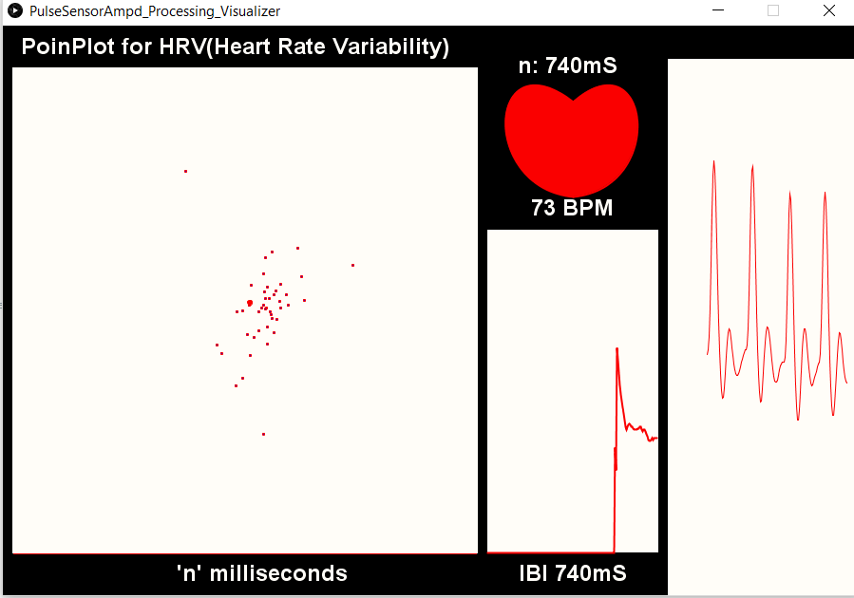
Normal Mode- HRV & Poncaire Plot
HRV refers to the natural variation in the time between each heartbeat, also known as the Inter-beat Interval, or IBI.
Here we graph the IBI values as well as show what the sensor is reading in mS

Slide 9
Normal Mode- BPM
Beats per minute(BPM) calculate how many times on average your heart beats per minute
In this picture we have labeled BPM
We also graph each BPM to see how steady/unsteady someones heart rate is.
We can monitor when a person went into Stress Mode, Regular Mode, or Meditation Mode.

Slide 10
Normal Mode- Pulse Wave
Lastly, as we can see the third graph represents a Pulse Wave Graph.
This is good to have to make sure everything is okay in general.
If your pulse rate graph looks weird or different from general pulse waves generated, it’s probably a good idea to monitor it and notify your doctor.

Slide 11
Next up two modes...
Stress Mode and Meditation Mode

Slide 12
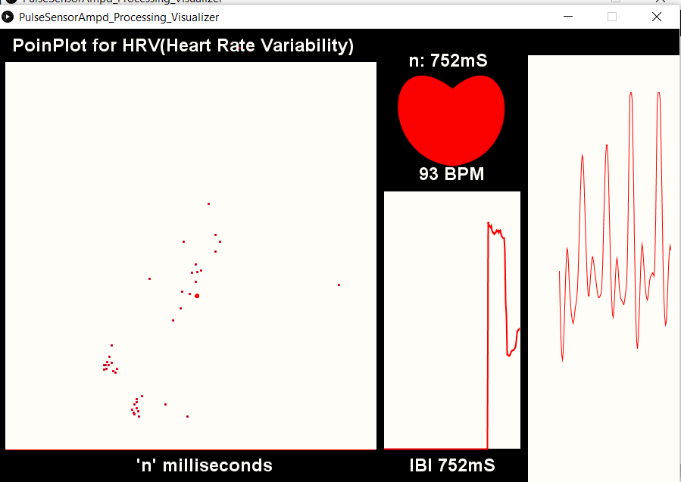
Stress Mode vs “Normal Mode”

Slide 13

Meditation Mode vs “Normal mode”

Slide 14
Improvements/Drawbacks
The inability to send long strings of data to a computer or a phone without data loss.
This prevented us from making the device fully bluetooth. An Improvement could be make it able to send all data over bluetooth

Slide 15
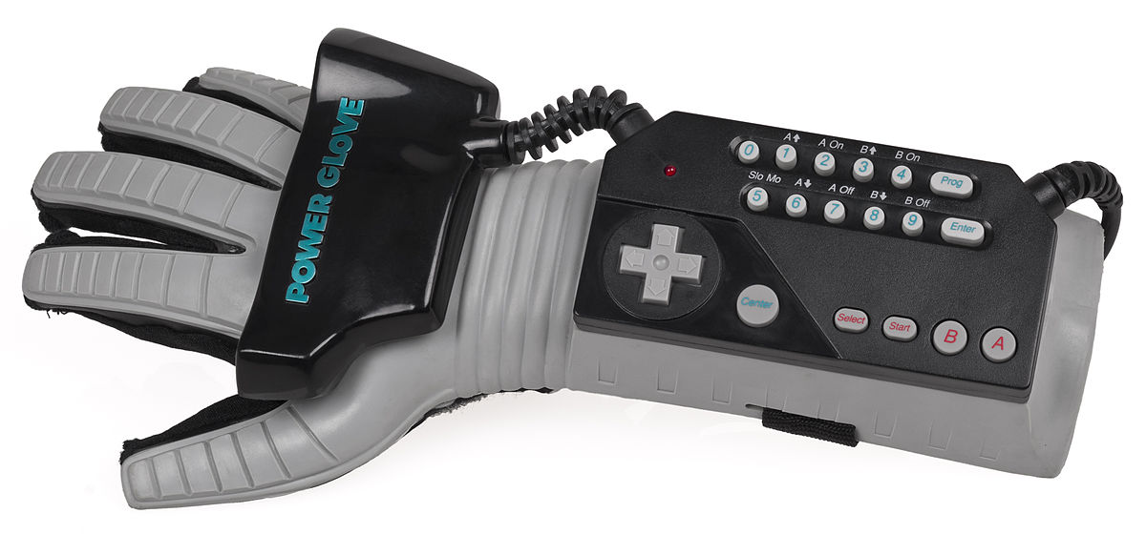
Conclusion
Overall this product is aimed for people to be able to calculate their heart beat anytime and anywhere
The device is made portable and put together in a way where the person using it won’t feel uncomfortable having the device with them.
It’s almost as if you had a regular glove on in the winter time!

Slide 16
Thank You

